Slide 1
Cyber Security in Banking
By : Abhijeet Singh

Slide 2
Problem Statement
Banking : In Banking system everybody has to have an account to access the system and its facilities. In today’s scenario majorly only those people can access the system and also its facilities who know the actual know how of the system but in areas where people are illiterate and or people who are naïve Like children, need a guide who can look around their financial statements
Cyber Security :Cyber Security Problem : Handling the issues along with the different aspects like escalation and conformation

Slide 3
Proposed Solution
Banking : The project is basically allowing a single account can be handled by different persons with different level access granted to users. So that person who is head of the family can set different access and withdraw level to manage the monthly expenses for example parent can put a 100 $ cap on child’s monthly expense so that child with his account can access that much and can only see his only account details though parent can see all child’s account details.
Cyber Security : Having tier based incident management to include not just Cyber security but also helpdesk , Legal advisory team and Back ground analysis Team.

Slide 4
Use cases
Banking :
1.)Adding multiple account with parent child relation
2.)Parent account can manage child account
3.) Child account can not access parent
Cyber Security
1.)Having Tier based incident management
2.)Having helpdesk to register the complaint
3.) Having few criteria to detect threat

Slide 5
Functionality
Required Functionality:
1. Bank will have different department like Legal, Operational, Financial and Cyber security team.
2. Users will have different level of access.
3. Enable users to raise the incidents.
4. Incident team will manage the incident and also consult different departments for approval.
5. Users access can be blocked or revived based on different scenarios.
6. Anomalies detected will be reported and also analyzed based on different parameters.
7. Focus will be more on Multi-user account and Cyber security rather than major banking functionalities.
8. Legal department will analyze and approve the legal aspects of cyber security threats and also payment issues.
9. Incident Response Team will manage the flow and distribution of the incidents.
10. Different teams and Users will be allocated different priority based incident based on their priority and resolution time.

Slide 6
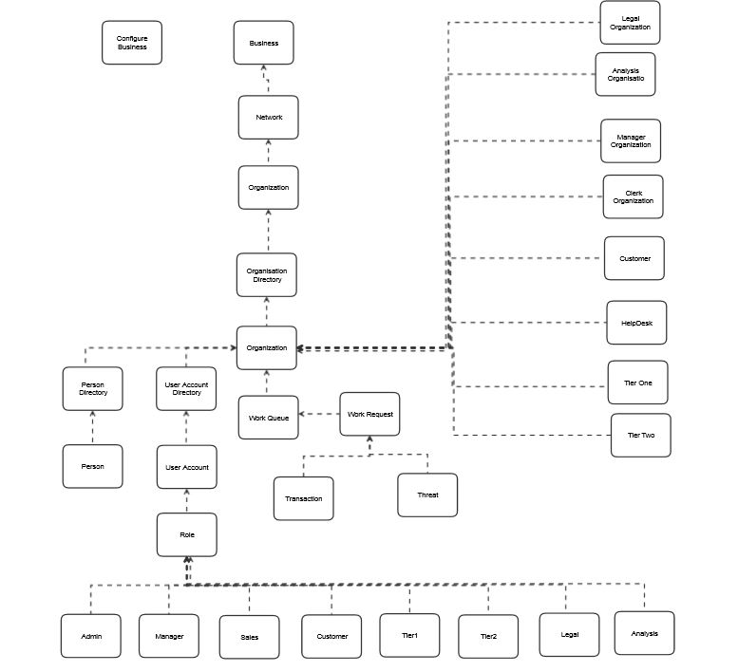
Object Model

